Slide 1
Java JDBC

Slide 2
JDBC stands for Java Database Connectivity.
JDBC is a Java API to connect and execute the query with the database.
It is a part of JavaSE (Java Standard Edition).
JDBC API uses JDBC drivers to connect with the database.

Slide 3
There are four types of JDBC drivers:
JDBC-ODBC Bridge Driver,
Native Driver,
Network Protocol Driver, and
Thin Driver
Use JDBC API to access tabular data stored in any relational database.
With the help of JDBC API, we can save, update, delete and fetch data from the database.

Slide 4
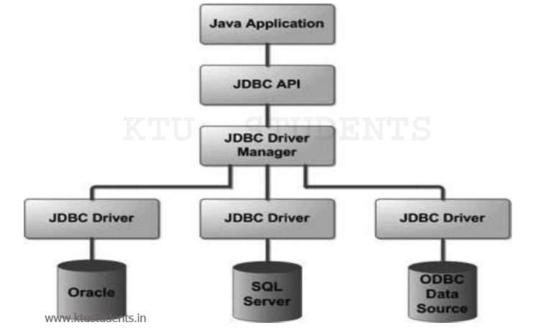

Slide 5
The java.sql package contains classes and interfaces for JDBC API.
A list of popular interfaces of JDBC API are given below:
Driver interface
Connection interface
Statement interface
PreparedStatement interface
CallableStatement interface
ResultSet interface
ResultSetMetaData interface
DatabaseMetaData interface
RowSet interface

Slide 6
A list of popular classes of JDBC API are given below:
DriverManager class
Blob class
Clob class
Types class

Slide 7
can use JDBC API to handle database using Java program and can perform the following activities:
Connect to the database
Execute queries and update statements to the database
Retrieve the result received from the database.

Slide 8
Java Database Connectivity with 5 Steps
5 steps to connect any java application with the database using JDBC:
Register the Driver class
Create connection
Create statement
Execute queries
Close connection

Slide 9
1) Register the driver class
forName() method of Class class is used to register the driver class.
method is used to dynamically load the driver class
Syntax:
public static void forName(String className)throws ClassNotFoundException
Eg:
Class.forName("oracle.jdbc.driver.OracleDriver");

Slide 10
2) Create the connection object
getConnection() method of DriverManager class is used to establish connection with the database.
Syntax:
public static Connection getConnection(String url)throws SQLException
public static Connection getConnection(String url,String name,String password)throws SQLException
Eg:
Connection con=DriverManager.getConnection( "jdbc:oracle:thin:@localhost:1521:xe","system","password");

Slide 11
3) Create the Statement object
createStatement() method of Connection interface is used to create statement.
The object of statement is responsible to execute queries with the database.
Syntax
public Statement createStatement()throws SQLException
Eg:
Statement stmt=con.createStatement();

Slide 12
4) Execute the query
The executeQuery() method of Statement interface is used to execute queries to the database.
This method returns the object of ResultSet that can be used to get all the records of a table.
Syntax :
public ResultSet executeQuery(String sql)throws SQLException
Eg:
ResultSet rs=stmt.executeQuery("select * from emp");
while(rs.next()){
System.out.println(rs.getInt(1)+" "+rs.getString(2));
}

Slide 13
5) Close the connection object
By closing connection object statement and ResultSet will be closed automatically.
The close() method of Connection interface is used to close the connection.
Syntax:
public void close()throws SQLException
Eg:
con.close();

Slide 14
import java.sql.*;
class MysqlCon {
public static void main(String args[]) {
try {
Class.forName("com.mysql.jdbc.Driver");
Connection con=DriverManager.getConnection(
"jdbc:mysql://localhost:3306/sonoo","root","root"); // here sonoo is database name, root is username and password
Statement stmt=con.createStatement();
ResultSet rs=stmt.executeQuery("select * from emp");
while(rs.next())
System.out.println(rs.getInt(1)+" "+
rs.getString(2)+" "+rs.getString(3));
con.close();
} catch(Exception e){ System.out.println(e);}
}
}

